Slide 1
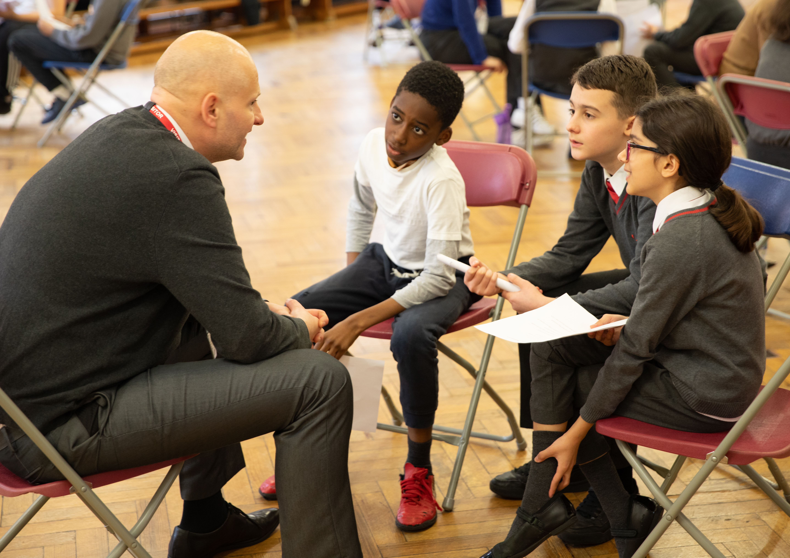

Aspiration Day
Preparing for your conversations

Slide 2

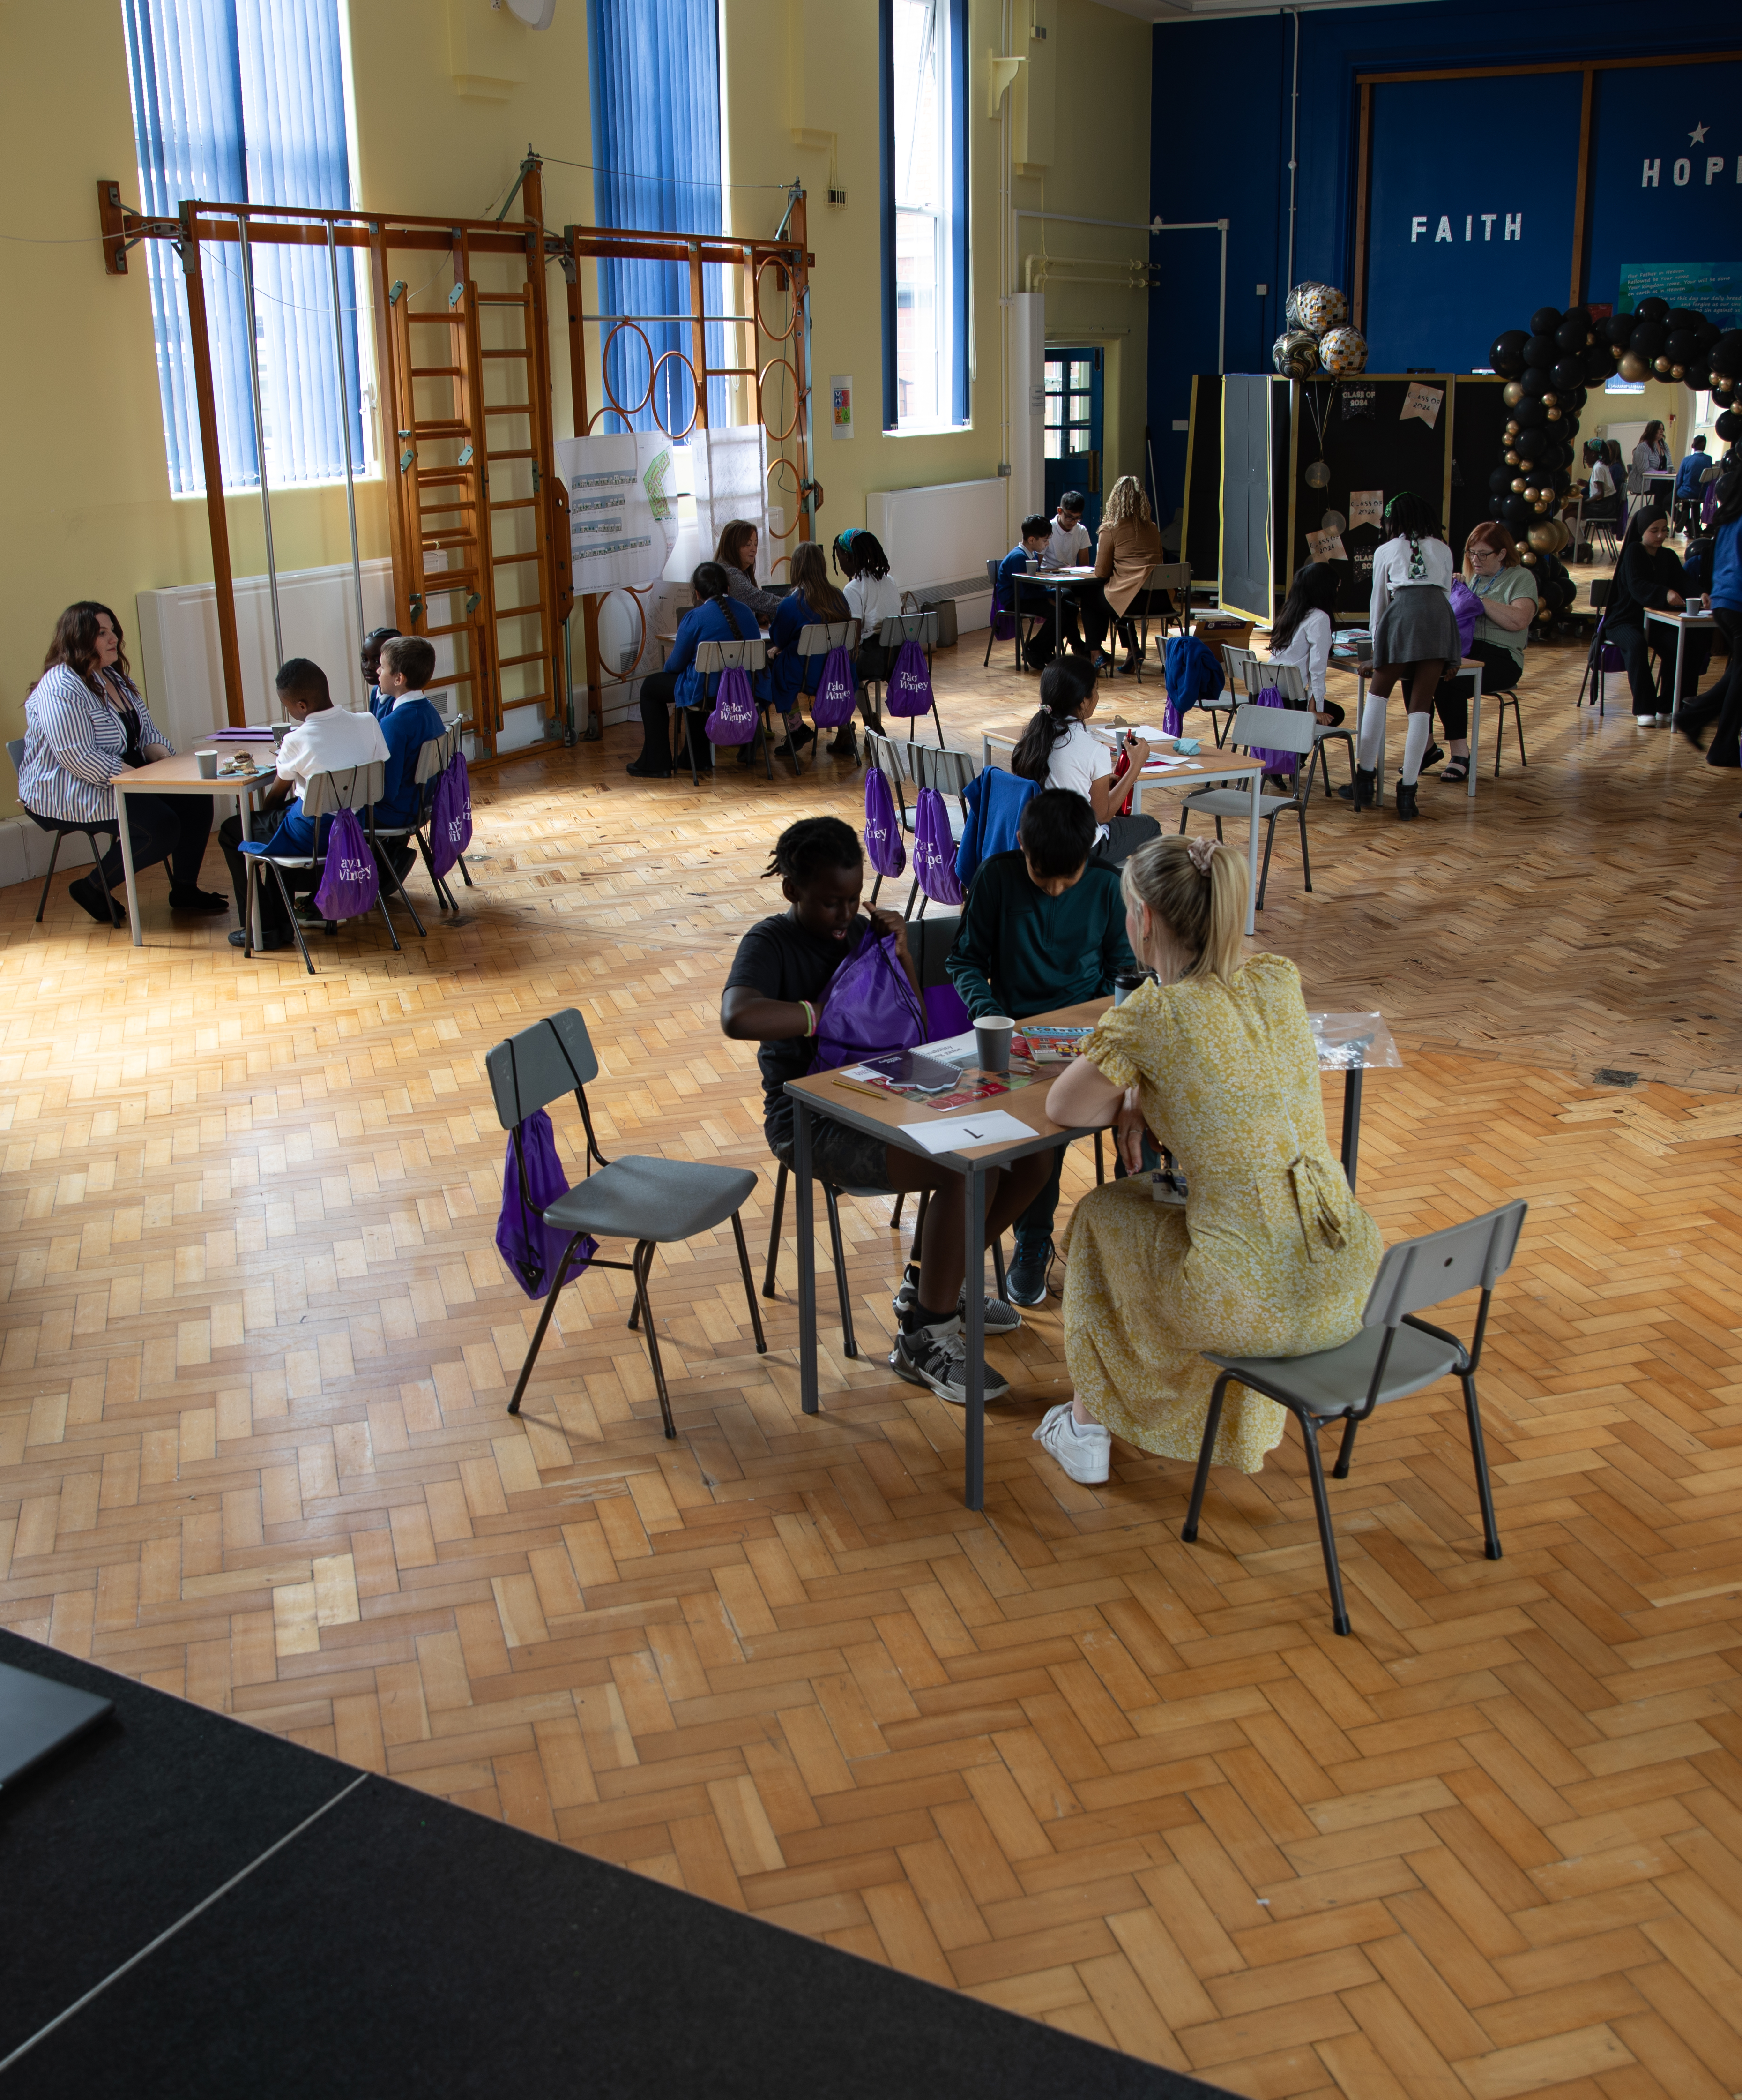
What is an
Aspiration Day?
An Aspiration Day is an event during which people from a company come to your school to speak with you about their jobs. They will spend about an hour and a half with you, and you can ask them any questions you want! This lesson will help you come up with your questions.

Slide 3
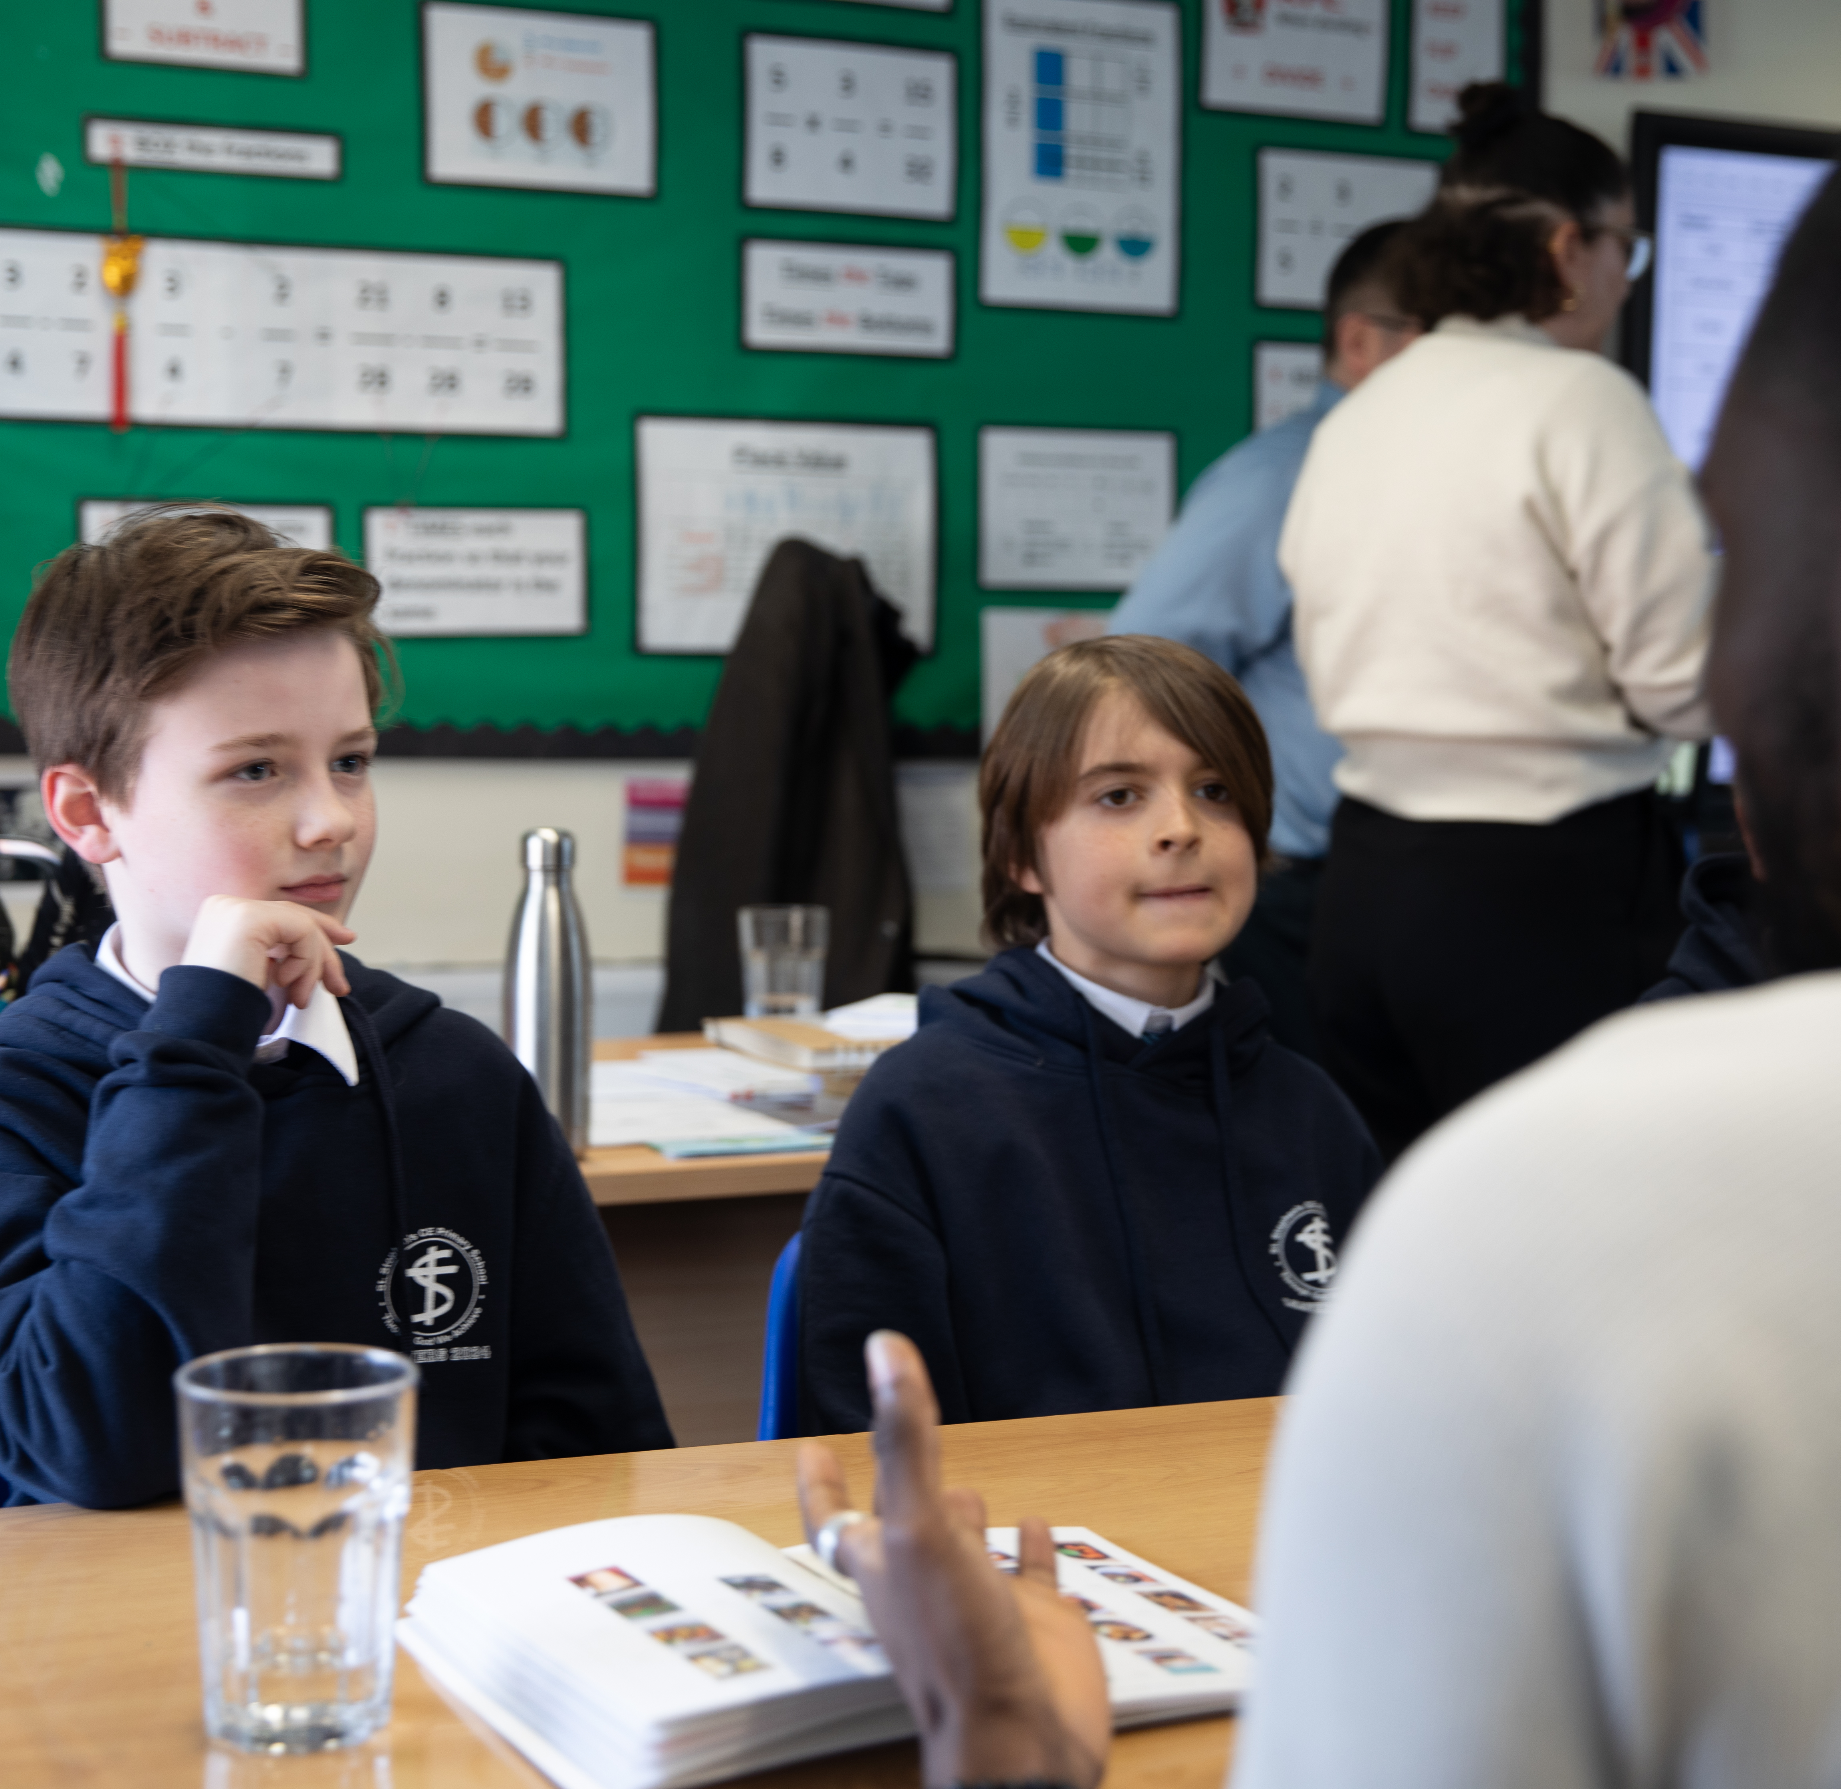


Employment – what does it mean?
Employment
Brainstorm as many jobs as you can think of

Slide 4
Key vocabulary
Employment

Slide 5
Key vocabulary
Word | Meaning
a) Employee | 1) This is the path a person takes through all the different jobs and work experiences they have over time.
b) Career | 2) This is a way of learning a job by working with someone who is very good at it. It's like being a helper and a student at the same time.
c) Volunteer | 3) This is a person who works for someone else or for a company and gets paid for the work they do.
d) Apprenticeship | 4) This is a special award you get when you finish studying at a college or university. It's like a certificate that shows you have learned a lot about a particular subject.
e) Degree | 5) This is a person who helps others or does work without getting paid. They choose to give their time and effort to make things better for people, animals, or the community because they care.
f) Skill | 6) This is something you can do well because you have learned and practiced it. It's like a special ability or talent, such as playing a sport, drawing, or solving math problems.

Slide 6




Key vocabulary - answers
Word | Meaning
a) Employee | 1) This is the path a person takes through all the different jobs and work experiences they have over time.
b) Career | 2) This is a way of learning a job by working with someone who is very good at it. It's like being a helper and a student at the same time.
c) Volunteer | 3) This is a person who works for someone else or for a company and gets paid for the work they do.
d) Apprenticeship | 4) This is a special award you get when you finish studying at a college or university. It's like a certificate that shows you have learned a lot about a particular subject.
e) Degree | 5) This is a person who helps others or does work without getting paid. They choose to give their time and effort to make things better for people, animals, or the community because they care.
f) Skill | 6) This is something you can do well because you have learned and practiced it. It's like a special ability or talent, such as playing a sport, drawing, or solving math problems.

Slide 7
The company
Employment

Slide 8

The company
Find the company online and answer the questions below.
The company
What does the company do?
What’s one thing you like about the company?
What’s one thing you are confused about or have a question about?

Slide 9

The company
Find the company online and answer the questions below.
The company
How many people work there?
Do they offer work experience?
Do they have an apprenticeship or a traineeship for young people?

Slide 10
Your questions
Employment

Slide 11

Questions
For your volunteers
Having read through the website and spoken about different jobs at the company…
Write down as many questions as you can think of for the staff at the company.
The questions can be:
About the people
About the organisation
About specific things you are curious about
Key words:
Education
Day-to-day
Challenges
Apprenticeship
Success
Hobbies and interests
Failure
Skills
Knowledge
Colleagues
Example question:
‘Can you remember a time when your plans failed? How did you deal with the situation?’
‘What would happen if I start a degree apprenticeship but decide that I don’t like it?’

Slide 12
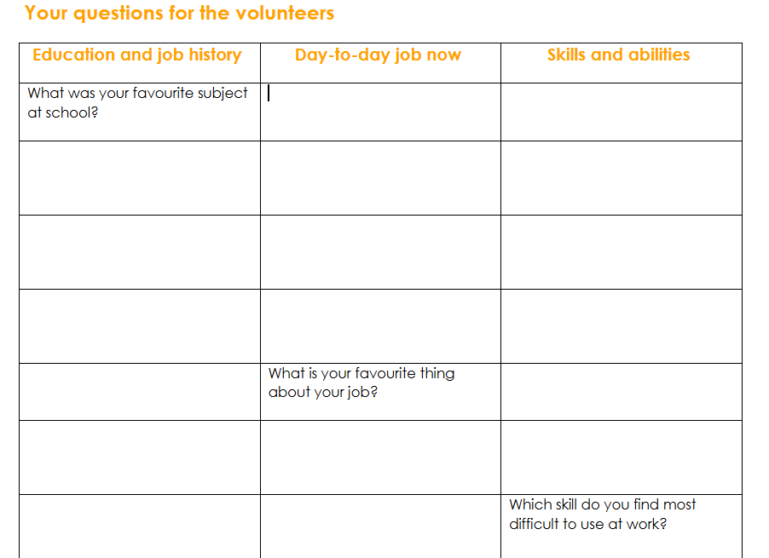
Your categories of questions
Now that you’ve brainstormed your questions, add them to your worksheet in the different categories.
Don’t worry about filling up all the spaces – there are more suggestions for questions on the next slides!

Slide 13


Here are some extra questions – would you like to use any of them?
Your questions
What is your day-to-day job like?
What’s your favourite thing about your job?
What three skills do you need the most to do well?
What did you study? Did you go to university?
Could you share about a time when things didn’t go as planned? How did you manage the disappointment and worry?
Do you have any hobbies outside of work which make you better at your job?
What did you learn at school that you find useful at your job now?

Slide 14
Pro-tips
1. Sometimes, it's easy to ask a question and then start thinking about the next one, without really hearing what the volunteer is saying. You will have the questions in front of you, so don't worry too much about what you're going to ask next. Instead, focus on what the volunteer is saying ☺
2. Ask each volunteer if they’ve already been asked questions from a category. If so, pick a different category to discuss so that the conversations can remain interesting and fun!
Your questions
14

Slide 15
Sharing who you are with the volunteers
Employment

Slide 16
Who you are
Employment
Think about what interests you and what jobs you might be curious to explore once you finish your education. You will practise answering some questions with your peers on the next slide.

Slide 17
Here are some questions your volunteers might ask you. Pick 3 and practice answering them.
Your questions
What kinds of things do you think you would enjoy doing for work as an adult?
What three skills do you enjoy using in your everyday life? (e.g., teamwork, leadership)
What one skill would you like to work on further? How are you planning to do that?
Could you share about a time when things didn’t go as planned at school? How did you manage the disappointment and worry?
Do you have any hobbies outside of school which would make you better at a future job?

